Slide 1

Attendance Management System for Teachers
Final Project Presentation
University of Management and Technology

Slide 2
Introduction
• Automates faculty attendance tracking
• Monitors in/out times, late arrivals, early departures
• Enforces policy rules for different staff types
• Demonstrates OOP and DSA concepts

Slide 3
Key Objectives
• Inheritance hierarchies (single, multiple, etc.)
• Data structures (BST, Stack, Queue, Graph)
• File-based data persistence
• Role-based access

Slide 4
System Architecture
• Inheritance Models:
- Single: Admin → Person
- Multiple: Teacher → Person + Attendance
- Multilevel: Attendance → TimeRecord
- Hierarchical: Department → Teacher
- Hybrid: ReportGenerator → Teacher

Slide 5
Core Components - Key Classes
• Person: Base class for human entities
• TimeRecord: Tracks check-in/out times
• Attendance: Calculates metrics
• Teacher: Manages attendance logging
• Admin: Teacher record management
• ReportGenerator: Generates daily reports

Slide 6

Data Structures
• Binary Search Tree (BST): Teacher search
• ActionStack (Stack): Undo admin actions
• LoginQueue (Queue): Login processing
• DepartmentGraph (Graph): Dept relationships

Slide 7
File Handling
• teachers.txt: Persistent teacher data
• attendance_log.txt: Daily records
• summary_report.txt: Summary reports

Slide 8
Functionality & Usage
• Teacher:
- Log in/out times
- View personal reports
• Admin:
- Manage teacher records
- Generate department reports
- Undo deletions

Slide 9
Algorithms
• Time conversion: 'HH:MM' to minutes
• Attendance metrics calculation
• BST search for efficient lookup

Slide 10
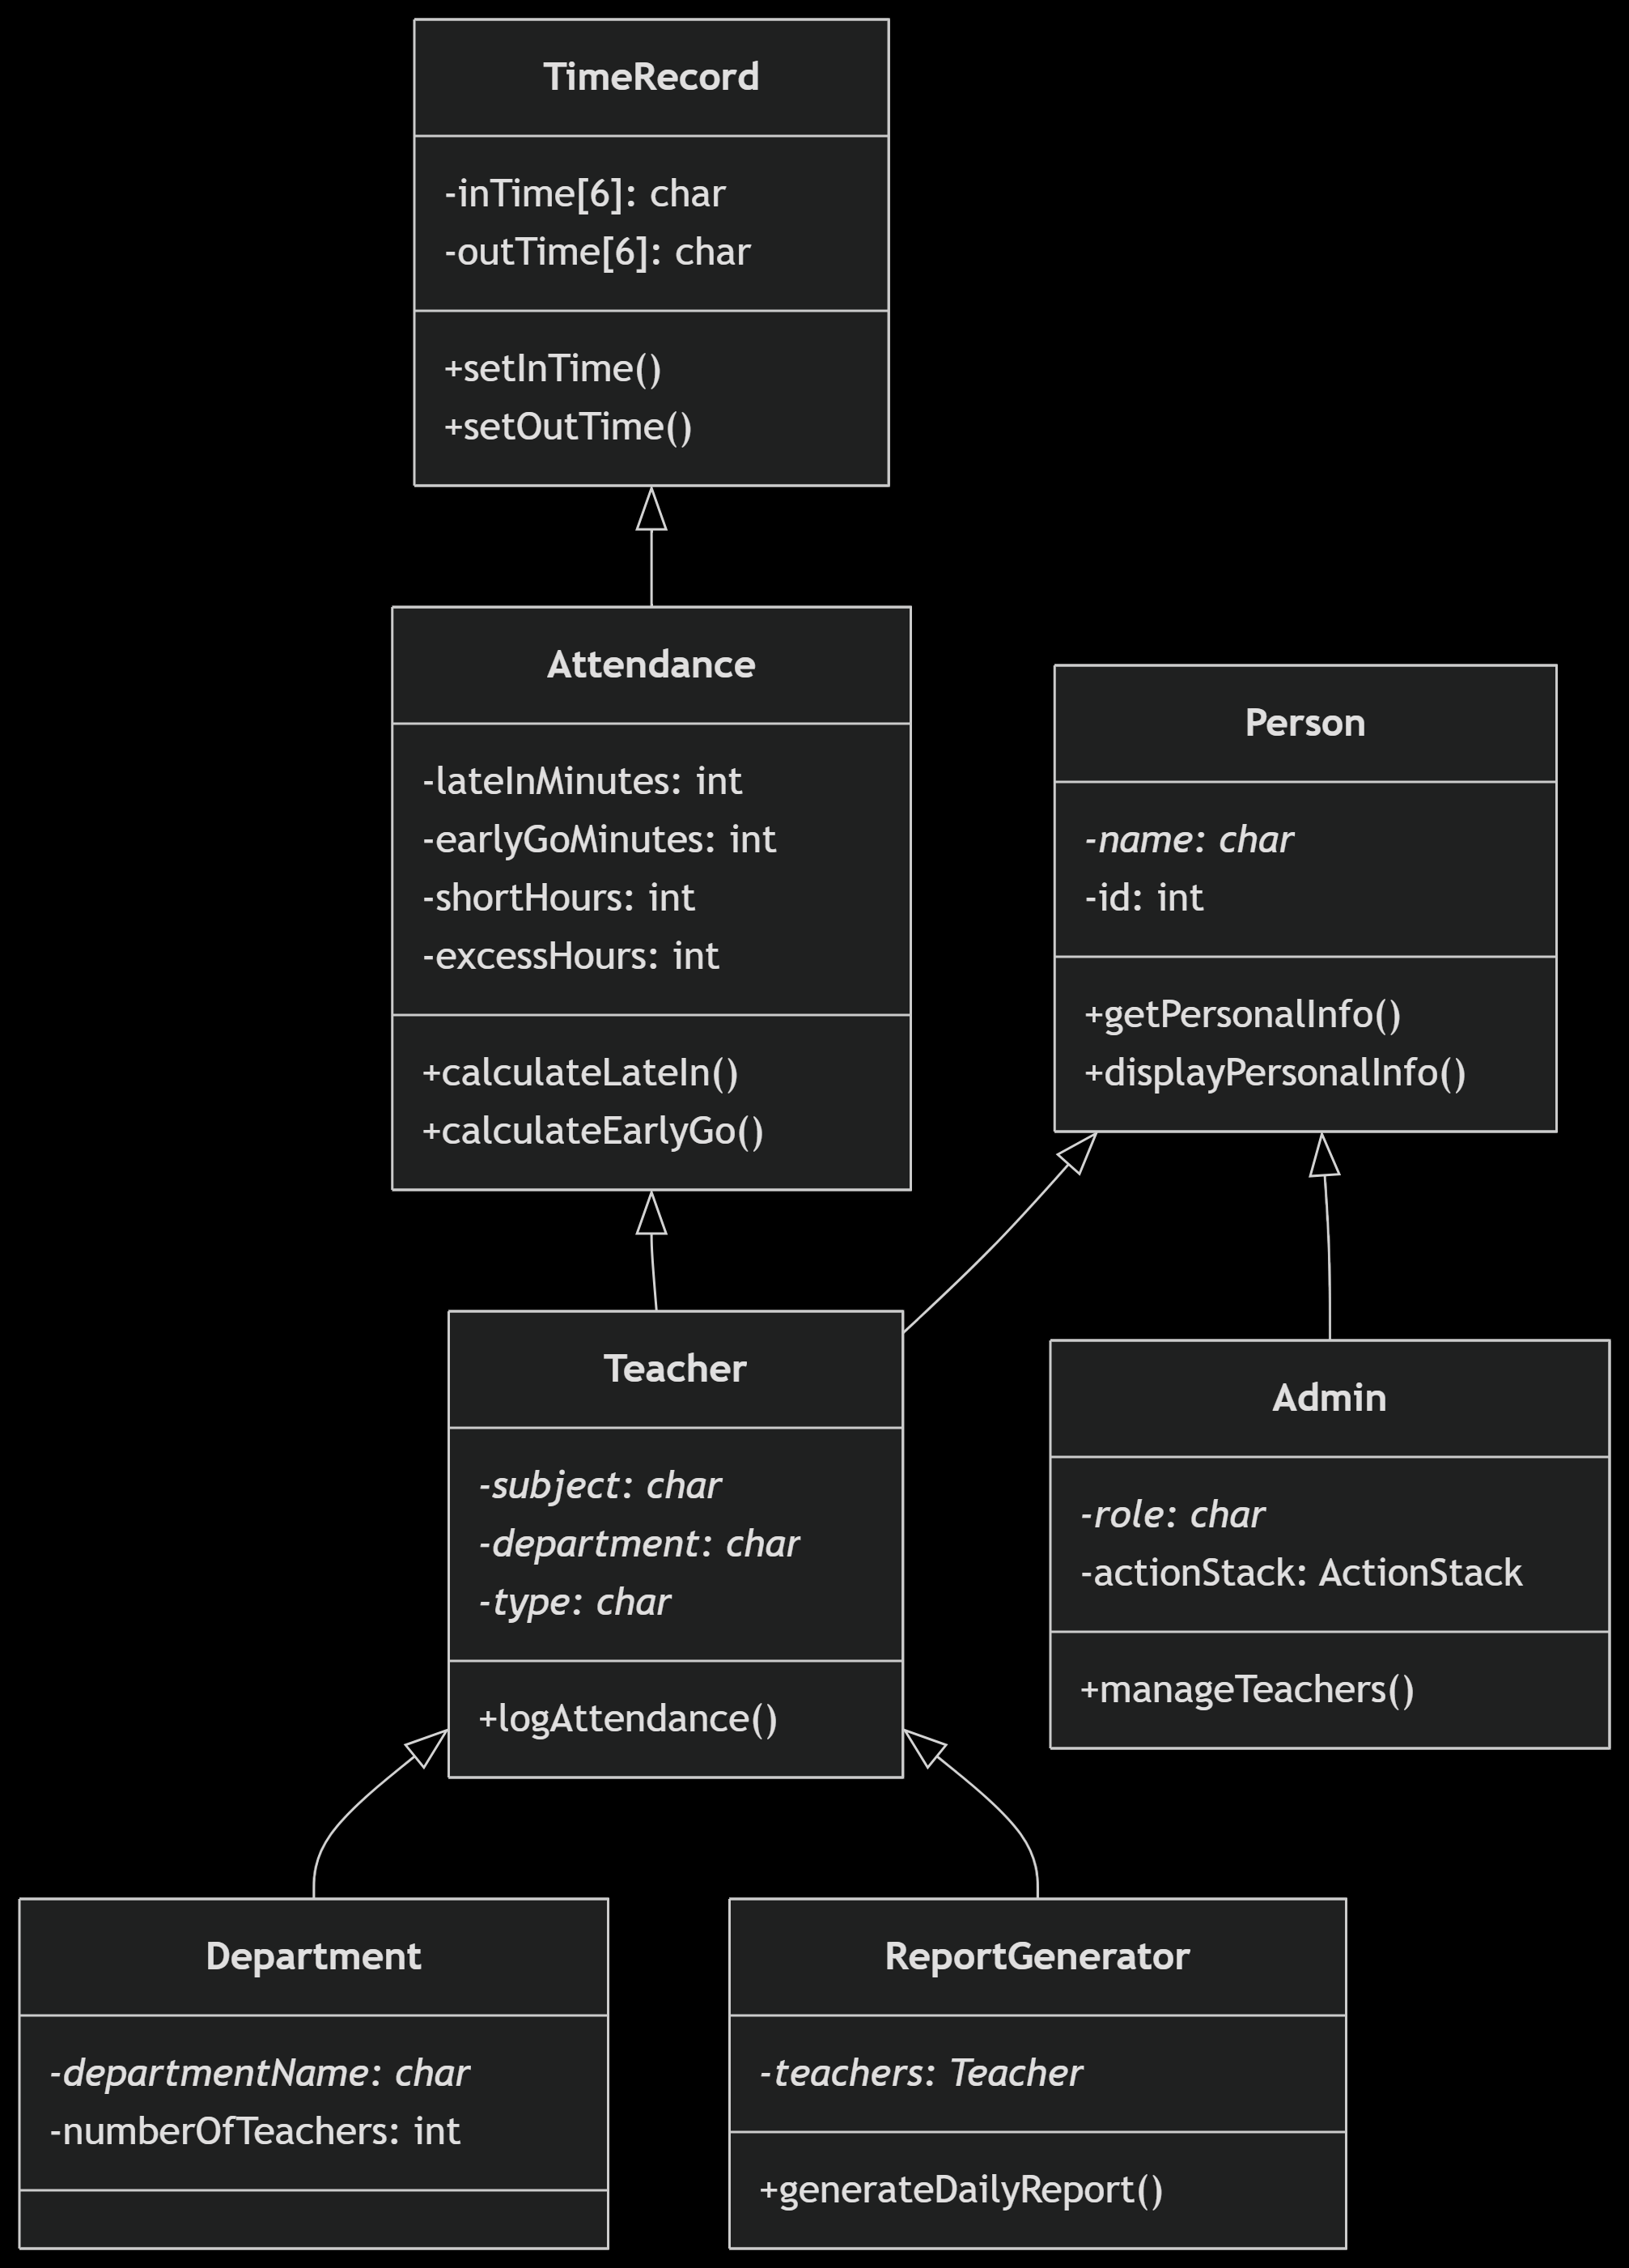
FlowChart

Slide 11
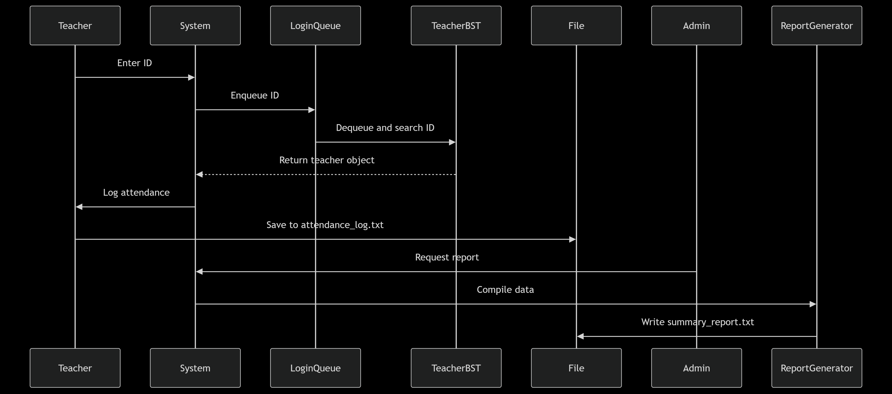

Slide 12
Error Handling
• Memory: All dynamic memory deallocated
• Input validation: Time format & ID checks
• File operations: Check success before I/O
• Edge cases handled: Empty stacks, full capacity

Slide 13
Conclusion
• 7 Classes with proper inheritance
• 6 Data structures with custom logic
• Persistent storage via files
• Policy-based tracking implemented
Future Enhancements:
• Monthly analytics
• Mobile app integration
• Biometric authentication
Code Stats: 850+ lines, 1 main.cpp, 3 output files

